Slide 1
Standard Query Language SQL
Lecture 1

Slide 2
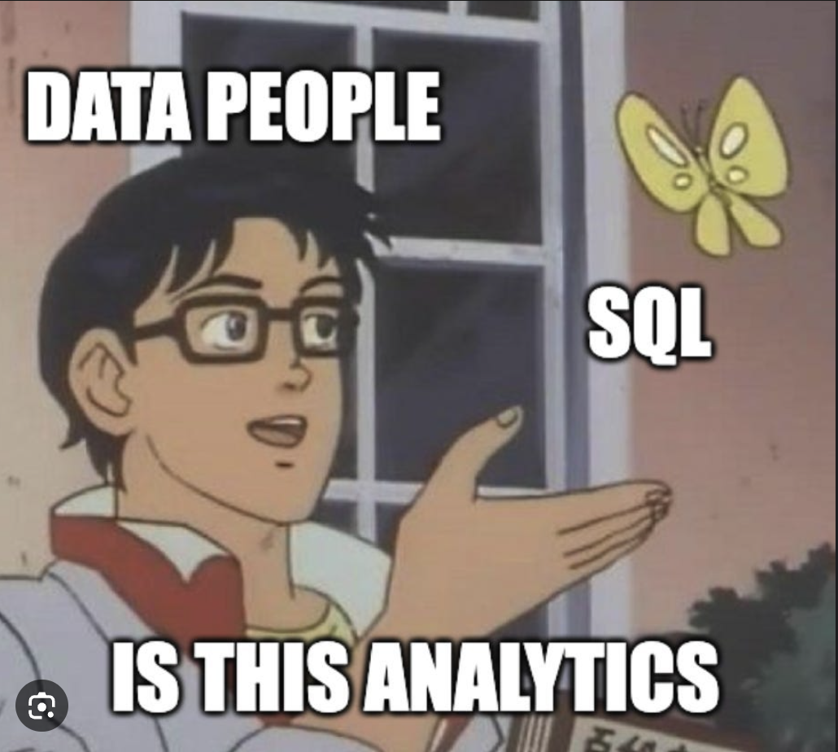

Slide 3
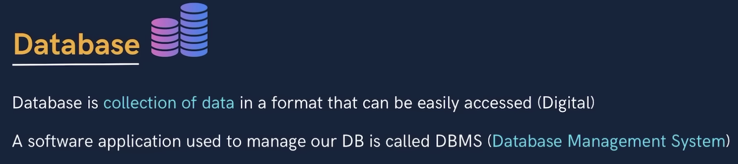
Database
USER DBMS DATABASE

Slide 4
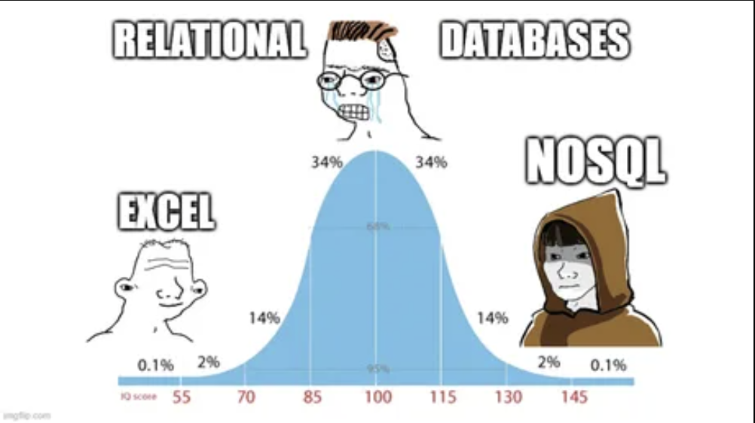
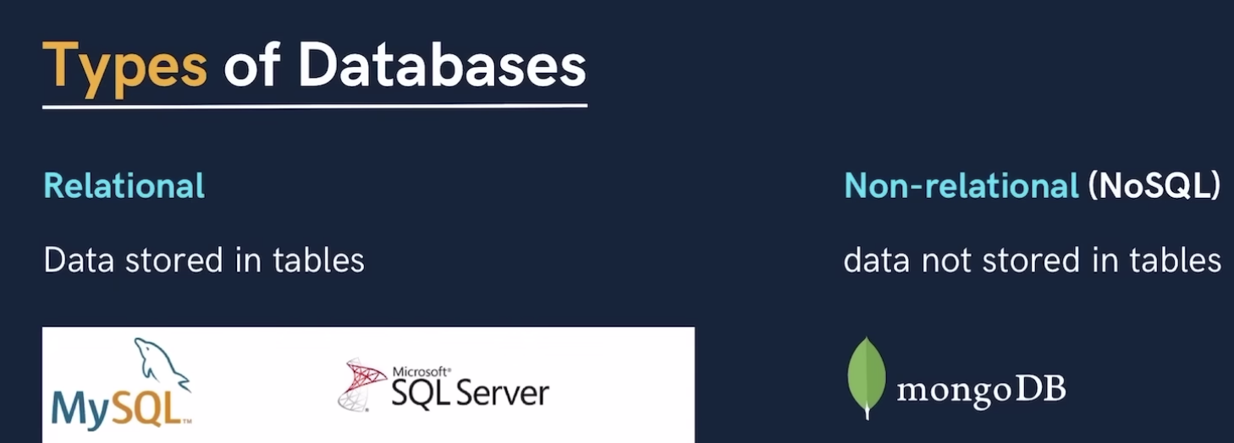
SQL and Databases
SQL is the language for generating, manipulating, and retrieving data from a relational database.
Types?

Slide 5
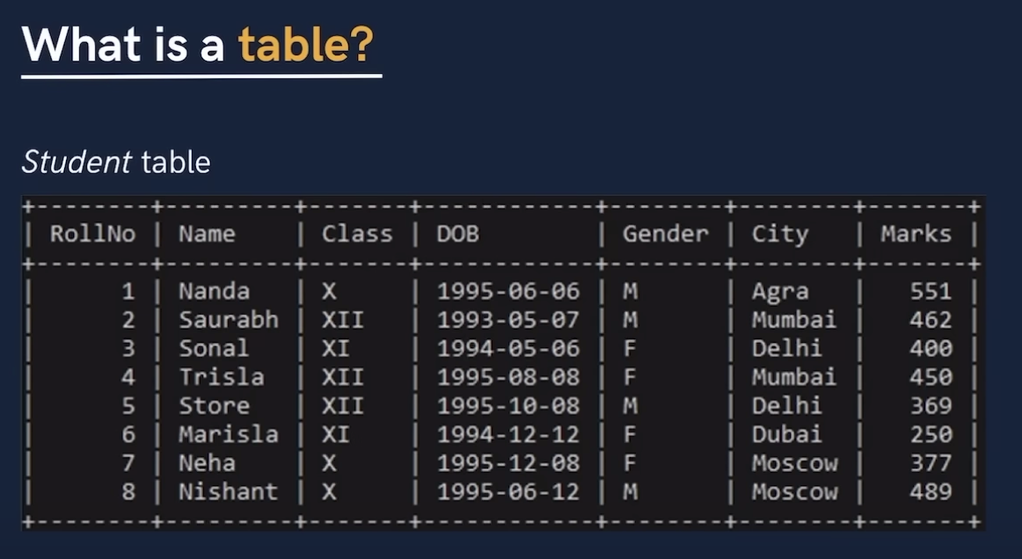
Table, Tuples, Fields, Schema, Primary Key, Foreign Key
Why not Excel?
SQL (Sequel) Vs. MySQL

Slide 6
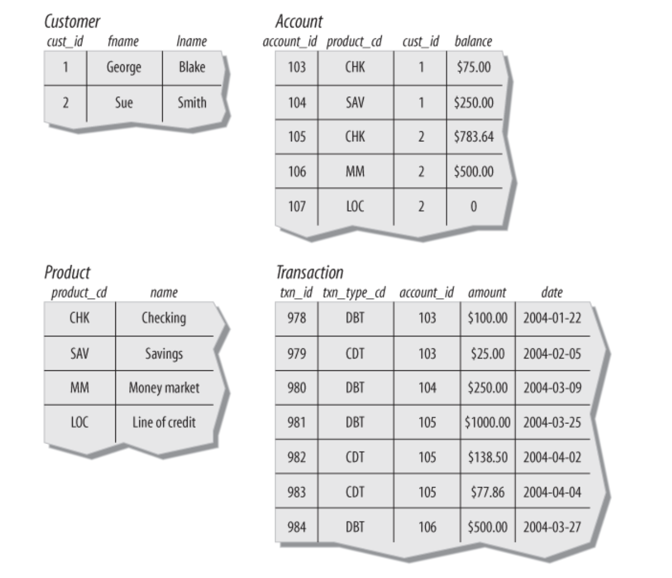
Relational Databases

Slide 7
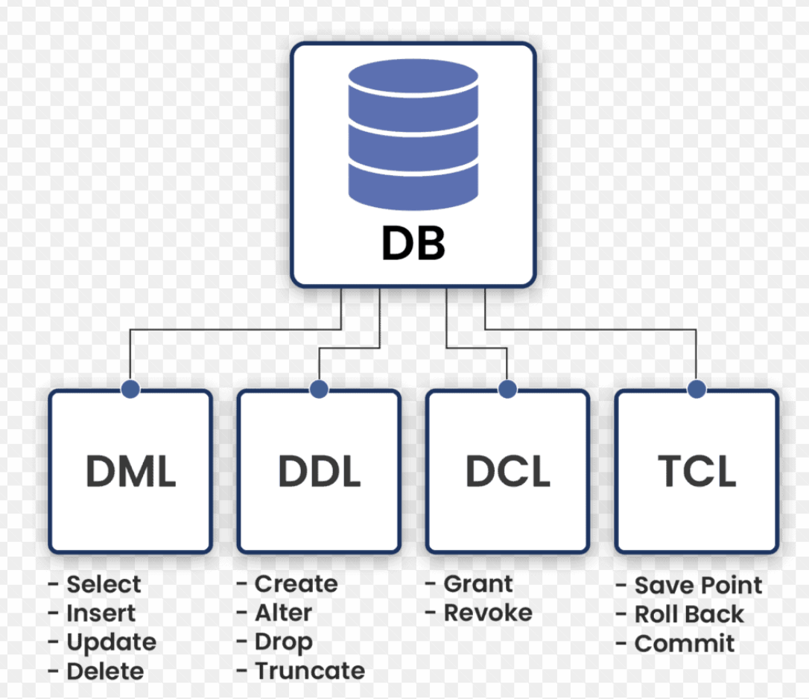
SQL Statements

Slide 8
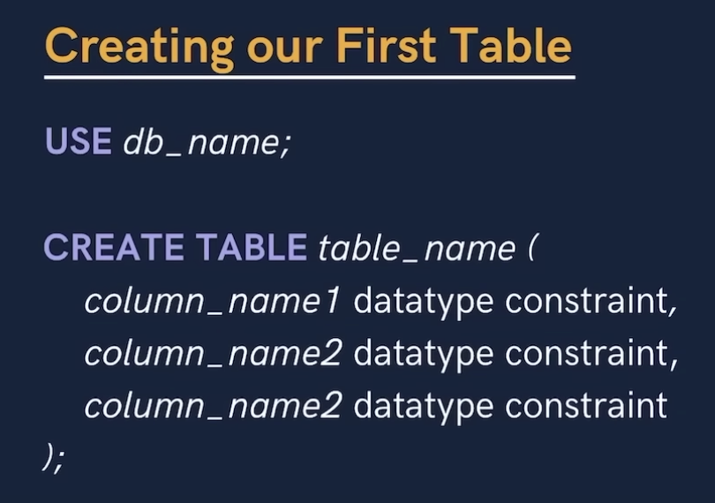
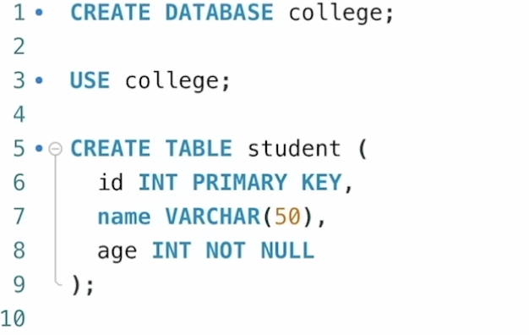
Creating Table and Databases
Dropping Table and Databases

Slide 9
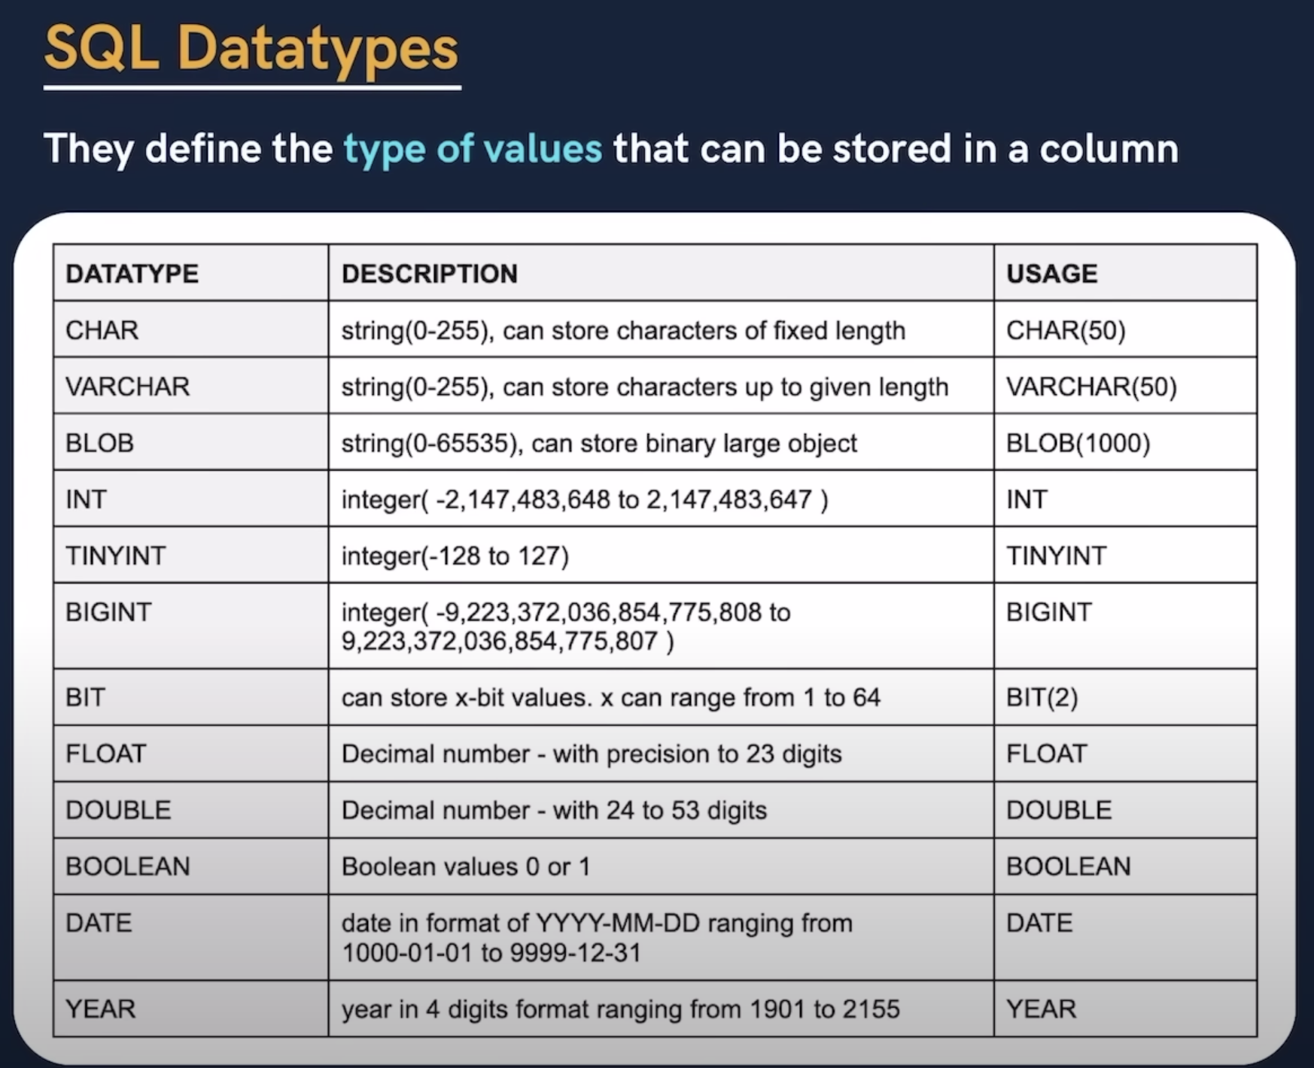
Data Types

Slide 10
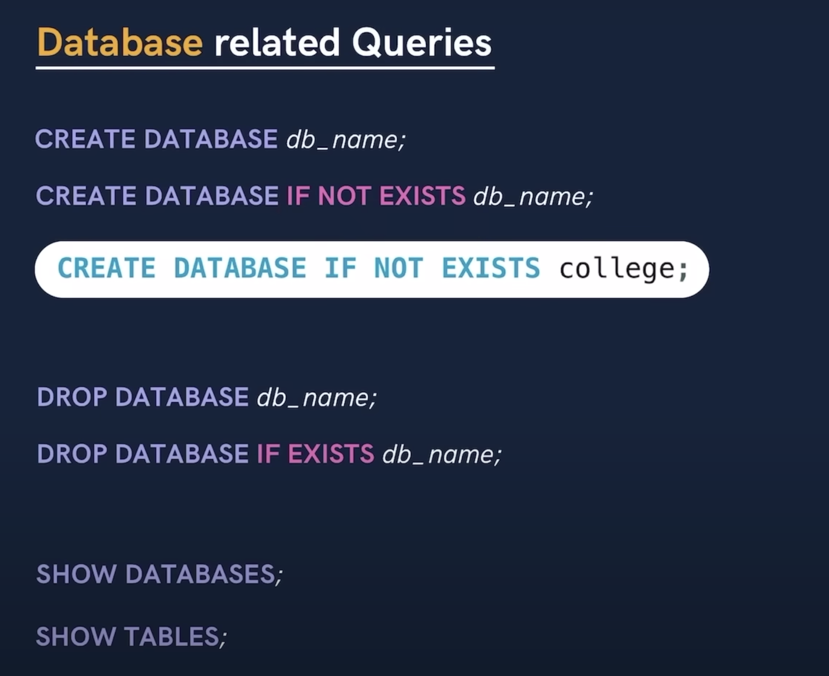

Slide 11
Material to Cover
Databases (Their control and administration)
Select statement
Selection of Database from toolbar or with command
HR Data exploration: How do we start
Entity Relationship Diagram (ERD)
Relationship type: Many, One
Joining Criteria
Importing the HR tables: Countries and Customers
Use of underscore instead of space

Slide 12
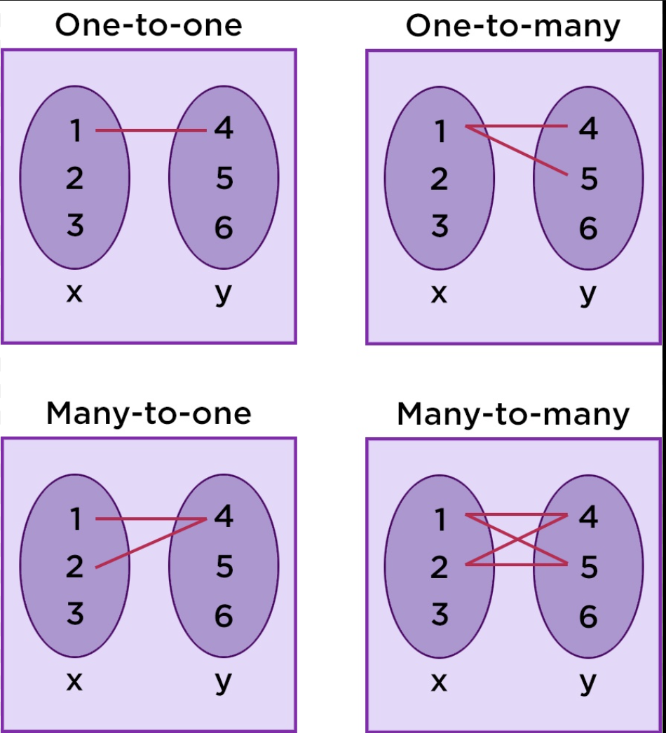
One to One: You and your ERP
Many to One: You all studying from me
One to Many: Me teaching you all
Many to Many: Other students studying from same professor that you have studied from.
Relationship of Customers to Country?

Slide 13
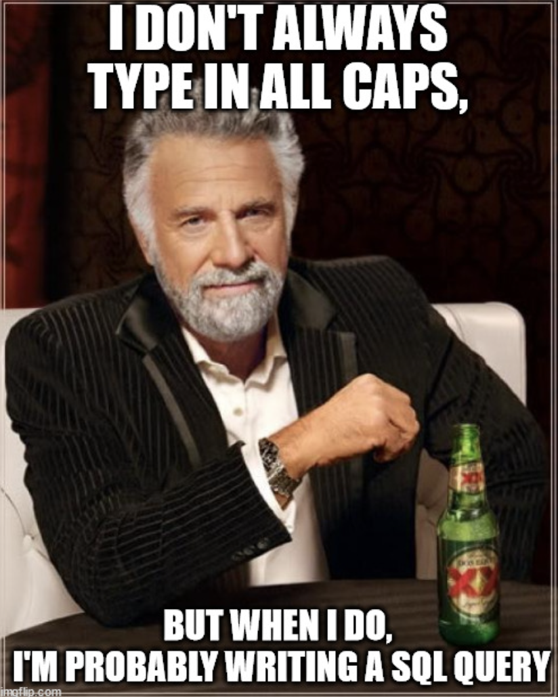

Slide 14
